Slide 1
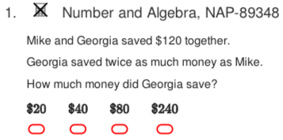
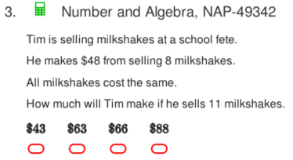
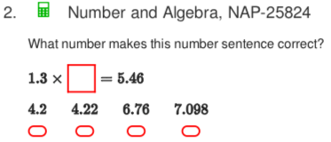
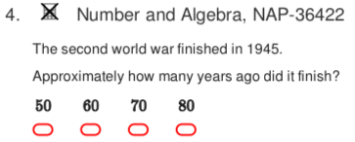
NAPLAN Starter Questions

Slide 2





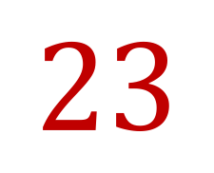

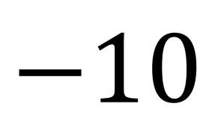
My Numbers and Operations Interactive Notebook
$$+$$
$$23$$
-1
$$−$$
$$×$$
$$÷$$
Name:
Class:
Teacher:
Semester 1
Term 1
$$5^{2}$$
$$0$$
$$−10$$

Slide 3

Interactive Notebooks!
Cover Page
Contents Page
Glossary
24/7/30
EQ
Questions
Notes
Summaries
Work page
Presentation!!!
Your book, your responsibility!

Slide 4


Slide 5
Contents
Glossary or Formula Page
Page
Date
Description
2
3

Slide 6

Learning Intentions
To learn a bit about the history of number systems✓
To further expand and solidify our mathematical vocabulary✓
To further learn the value of the place system
To compare, order, add and subtract integers
WICOR

Slide 7
BIMDAS Dominos Competition
RULES:
Get into groups of 4.
Get a set of dominos
You will be given a target number by me
You will then pick 2 dominos and use BIMDAS to get to the target number. You can pick and choose your dominos to get to the target number.
You must be prepared to show how you got your answer on the board for the points (3 pts per correct answer)

Slide 8
24
7
30
Number systems
Date
EQ – What are directed numbers and how do they relate to integers?
A few lessons ago we defined integers as positive and negative whole numbers, including 0.
Positive integers are all the whole numbers greater than zero {1,2,3,4,5,...}
Negative integers are all the opposites of those whole numbers {-1,-2,-3,-4,-5,...}
Zero is neither positive or negative.
-5 is the opposite of 5 and -243 is the opposite of 243. If an integers is greater than zero (> 0), we say it’s sign is positive (+). If it’s less than zero (< 0), we say it’s sign is negative (-)
Summary:

Slide 9

24
7
30
Number systems
Date
EQ – What are directed numbers and how do they relate to integers?
Positive and negative integers together are called directed numbers. Directed numbers show both direction and magnitude (size).
Ex: +7 or 7 means 7 units in the positive direction, while -3 means 3 units in the negative direction.
**Can you think of some everyday examples of negative integers?**
Integers are represented by the number line
Negative
Positive

Slide 10
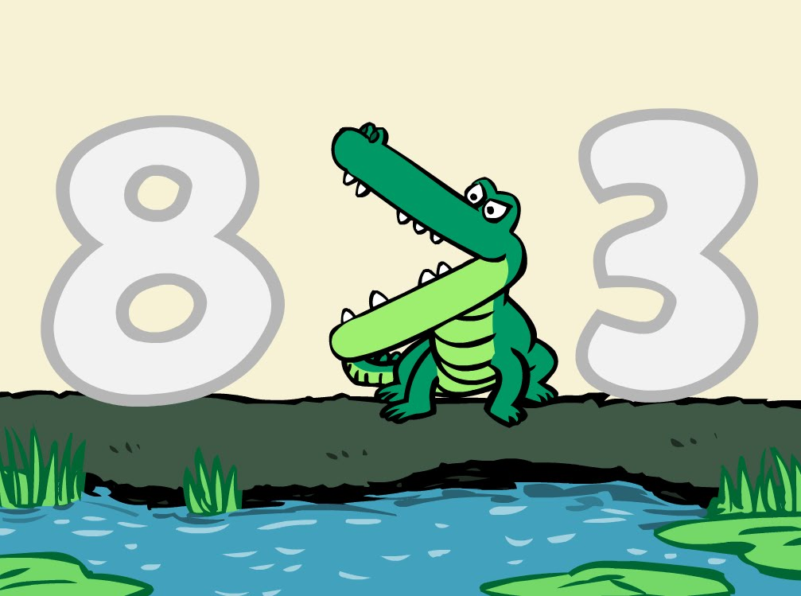
24
7
30
Number systems
Date
EQ – What are directed numbers and how do they relate to integers?
For any two different places on the number line, the integer on the right is greater than the integer on the left.
Ex: 8 is greater (or more) than 3.
This can be written as 8 > 1
Think of the > and the < signs as the jaws of a crocodile.
They always open towards the bigger number and point to the smaller number (the smaller number eats the bigger number).

Slide 11

Do you understand? Fists of Five
Notes:
Check for Understanding

Slide 12
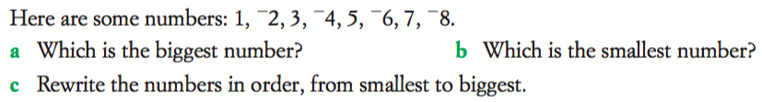
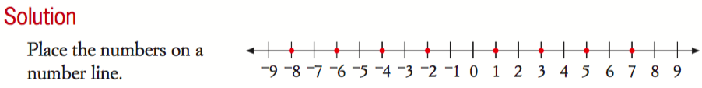

Slide 13

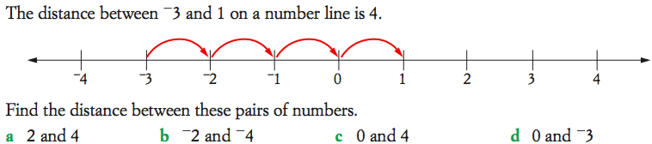

Slide 14
Complete Freefall Worksheet—
Directed Numbers/Number line and Magnitude

Slide 15
Homework
Complete Freefall Worksheet

Slide 16
24
7
30
Number systems
Date
EQ – What are directed numbers and how do they relate to integers?
Add any new terms/symbols to your
Glossary!!!
Complete your Summary!!!
Summary:

Slide 17
Notes Review
24, 7 ,30
Date
Title
Essential question
Notes complete
Notes complete with colour and diagrams
Questions completed
Contents page filled in
Formula page filled in

